Slide 1
Amaan Ala Ud Din
MasterSchool
Analytics with SpreadSheets.

Slide 2
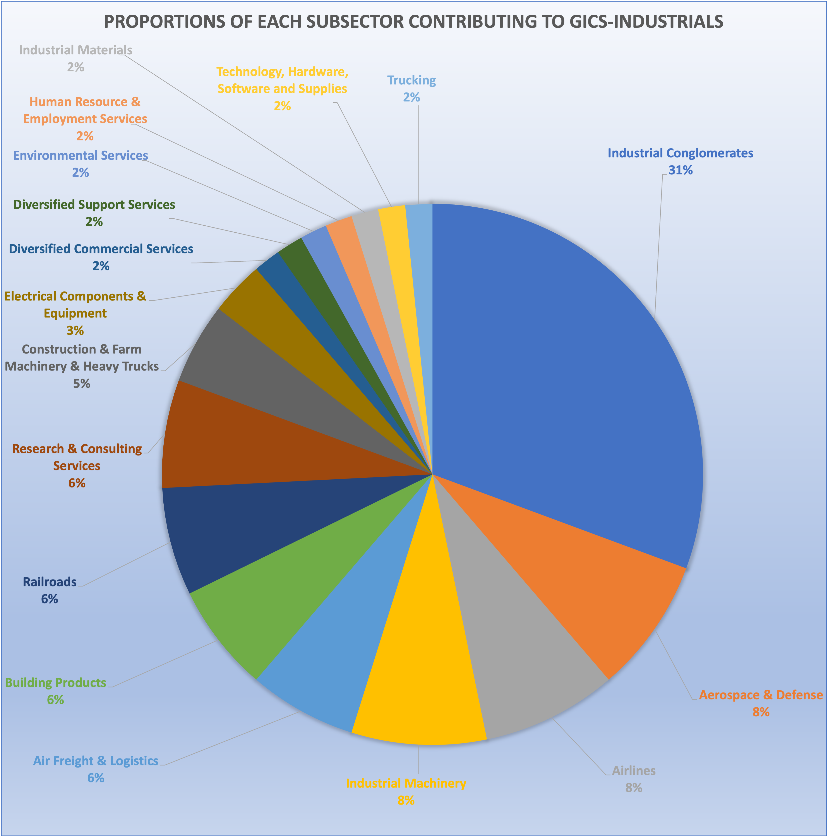
What are the proportions of shares among
GICS(Industrials) subsectors over the years 2013-2017?
For the first summary visualization, here we are looking at the shares of the GICS Industrials Sector.
Each subsector shows its respective proportions contributing towards the GICS-Industrials.

Slide 3
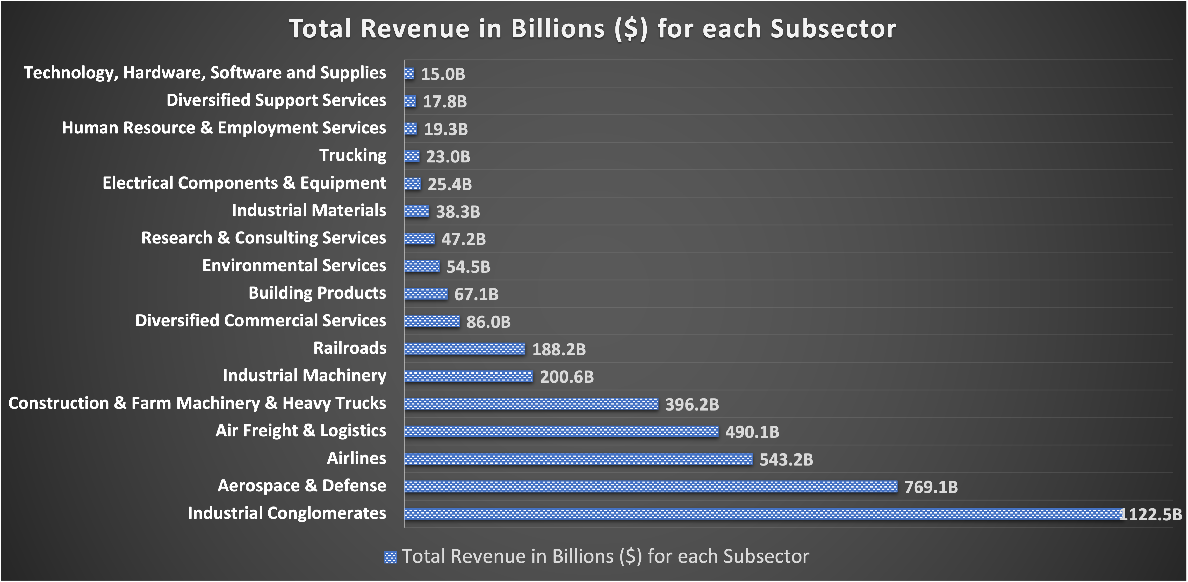
What is the distribution of Total Revenue generated by GICS(Industrials) subsectors over the years 2013-2017?
Here we are looking at the Total revenue generated by the GICS Industrials Sector.
We can see the distribution of GICS Industrials for each subsector. Industrial Conglomerates hold the highest Revenue for Industrials Sector.

Slide 4
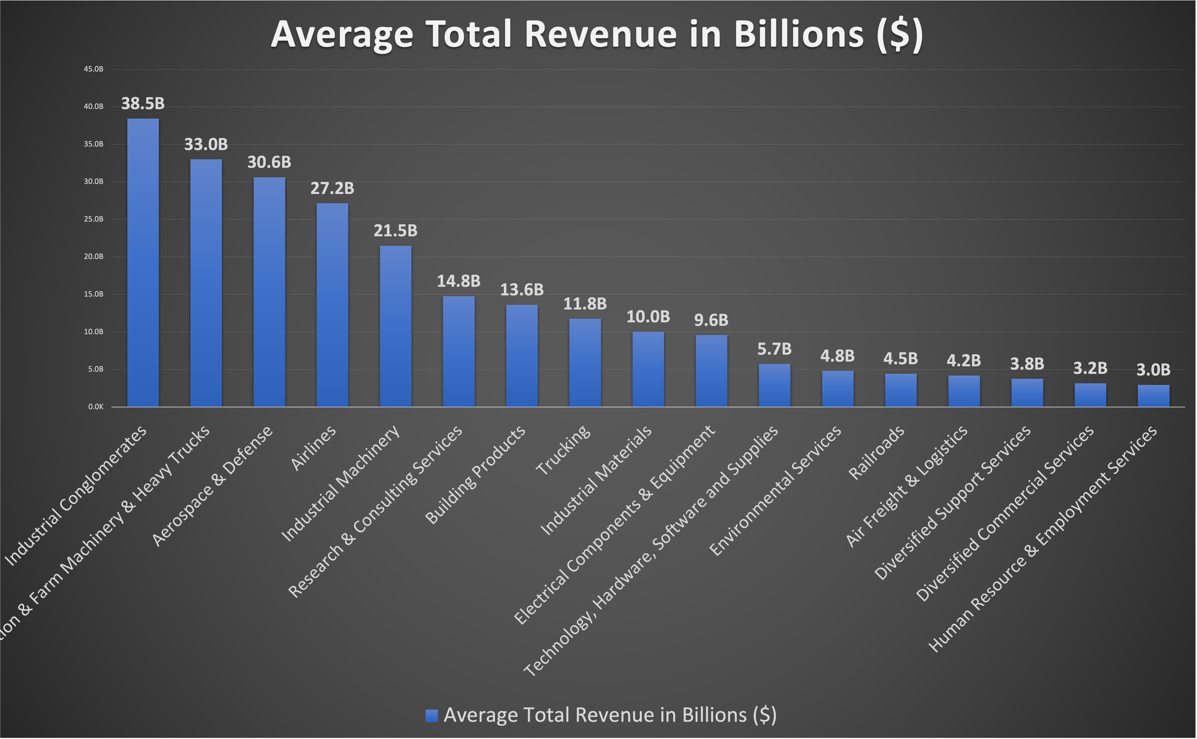
What is the Average Revenue generated by each
GICS(Industrials) subsectors over the years 2013-2017?
This bar chart shows the average revenue earned by the GICS Industrials Subsectors.
Contrary to the last slide, here it is visible that there is not much of significant difference in the average revenue earned by Industrial Conglomerates over the last 4 years. The adjacent subsectors are generating almost the same revenue.

Slide 5
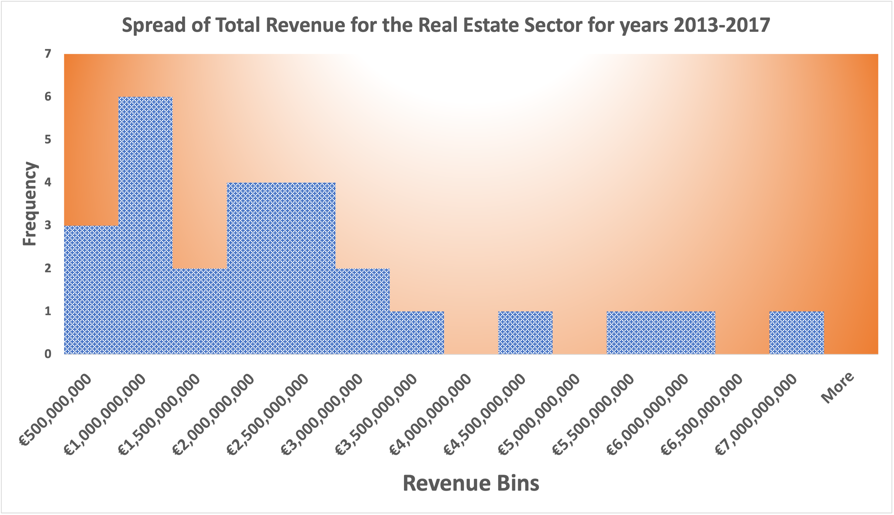
What is the Spread of Total Revenue generated by Real Estate subsectors over the years 2013-2017 ?
This chart shows the histogram for the Revenues for Real Estate Sector. This is a positively skewed or right-skewed distribution. Majority of the revenue points fall within the lower bracket of the entire revenues generated indicating that mean is higher than the median.
The Standard Deviation for Real Estate Sector is $1,683,460,381, which shows the variability in Revenue for each of these companies from one another. However, the range for this distribution is $6,104,703,000. As the range is large, the central tendency is not an accurate representative of the data. We can deduce that SD is a better measure for spread in this case as the value is more coherent with the spread because it depends on each data point instead of just two (maximum and minimum).

